Slide 1

Virtualization Migration Assessment For Telecom IT

Slide 2
Executive Summary
Phase | Key Activities | Deliverables / Outcomes | Duration | Estimated Pricing
Foundation | - Environment assessment & workload profiling - OpenShift cluster deployment on bare metal - Storage & network integration - Pilot migration of modern workloads - GitOps pipeline setup - Training & enablement - Security baseline setup | - Validate platform readiness - Successful pilot migrations - Build automation foundation - Team preparedness | 6 Months | $11,500,000
Expansion | - Scale OpenShift across all data centers - Migrate all remaining IT & telco workloads - Multi-zone HA & DR implementation - Resource optimization - Security hardening - Expand GitOps automation - Ongoing training - Stabilization & monitoring | - Complete full migration - Operational stability & performance - Enable continuous modernization - Compliance adherence | 35- 40 Months | $29,700,000
Red Hat Subscriptions after migration | Optimization and Ongoing SUpport | Subscription growth for: OpenShift Platform Plus | 3 year projection | $23,544,000
We have successfully completed the assessment of Telco Department 's VMware environment and has built a proposal to migrating 1440 VMware hypervisors to OpenShift Virtualization on bare metal infrastructure across 12 data centers. The migration addresses financial pressures, operational modernization, and platform consolidation

Slide 3
Estimated 5-Year TCO Comparison: VMware vs OpenShift
Category | Current VMware-Based Environment | OpenShift Virtualization Environment
Hypervisor Licensing | $48,000,000 (VMware vSphere, vCenter, etc.) | $0 (OpenShift Virtualization included)
Support & Maintenance | $12,000,000 | $1,800,000 (Red Hat Advanced Support)
Hardware (refresh + expansion) | $18,000,000 (full refresh, VMware design) | $10,500,000 (partial reuse, staged refresh)
Operational Costs | $10,000,000 (manual processes, silos) | $6,000,000 (GitOps automation savings)
Storage & Network Tools | $5,500,000 (proprietary integrations) | $3,000,000 (CSI/SDN with OpenShift)
Training & Re-skilling | $1,200,000 (VMware-specific) | $1,400,000 (OpenShift/GitOps/Hybrid-ready)
Containerization Enablement | $4,000,000 (additional tooling/licensing) | $0 (native in OpenShift platform)
🔻 Total Estimated TCO (5 Years) | ~$98.7M | ~$64.7M
Estimated Savings |  | ~$34 Million (~35% TCO reduction)

Slide 4




Objective and Our Proposition
Telco IT Objective | Our Proposition
1. Reduce Total Cost of Ownership (TCO) | Migrate from VMware to OpenShift Virtualization on bare metal, eliminating hypervisor license costs and lowering OPEX through automation and hardware reuse.
2. Enablement for Modernization | Enable seamless coexistence of VMs and containers on one platform; modernize applications progressively using GitOps and CI/CD pipelines.
3. Increase Operational Agility via Automation | Implement GitOps-based workflows, declarative infrastructure, and automation to accelerate deployments, updates, and rollback across all environments.
4. Future-Proof Architecture for Hybrid/Edge Readiness | Deliver an open, multi-cloud-capable platform (OpenShift) that supports future expansion to public cloud or edge environments without re-architecture.

Slide 5
Target Architecture and Infrastructure Considerations
Component | Description / Highlights
Deployment Model | OpenShift Container Platform with OpenShift Virtualization (KubeVirt) deployed on bare-metal servers
Hardware Strategy | Reuse existing servers where possible; selective new hardware procurement aligned with refresh cycles
Workload Types | Mixed workloads: Virtual Machines (legacy telco & IT apps) and Containers (modern microservices)
Data Centers & Zones | 12 Physical data centers divided into 4 network zones: Hogwarts, Mahoutokoro, Castelobruxo, Ilvermorny
Software Defined Networking | Juniper Fabric CLOS Leaf-Spine topology; Kubernetes SDN (OVN or similar); VLAN segmentation; no VMware NSX
Software Defined Storge | Supports EMC Symmetric, Oracle FS1, Dell EqualLogic, Pure FlashArrayX, CSI drivers for persistence + PortWorx for Storage Virtualization
Security & Compliance | RBAC, Kubernetes network policies, tenant isolation, integration with telco-grade security & compliance standards
Automation & Management | GitOps-based lifecycle management (e.g., ArgoCD); CI/CD pipelines; unified VM and container management
High Availability | Multi-zone cluster deployment with failover and disaster recovery capabilities
Monitoring & Logging | Centralized logging, monitoring, and alerting via OpenShift native tools
Application Examples | Telco workloads (vEPC, vRAN), IT workloads (JBoss, MS SQL Server, .NET 8.x apps)
The target architecture leverages OpenShift Virtualization on bare metal to unify virtual machine and container workloads across the Telco’s 12 data centers. It prioritizes hardware reuse, integrates with a high-performance Juniper leaf-spine fabric, and supports multi-vendor storage via CSI. The platform is designed for modern DevOps workflows using GitOps and CI/CD, with strong security controls, centralized observability, and multi-zone high availability. This future-proof architecture enables scalable, automated, and cost-efficient operations, ready for hybrid and edge deployment scenarios.

Slide 6
Network Infrastructure Considerations
Aspect | Details
Network Topology [4 Network Zones] | Juniper Fabric implementing a CLOS leaf-spine architecture for high bandwidth, low latency, and scalability
NIC Configuration | Servers equipped with 2x1Gbps NICs for management/out-of-band traffic, 2x10Gbps NICs for data traffic, and 1 FC HBA for SAN connectivity
Traffic Segmentation | VLAN segmentation to separate management, data, storage, and application traffic zones
OpenShift SDN Integration | Kubernetes native SDN (OVN or equivalent) manages pod and VM networking overlay without VMware NSX
Network Policies & Security | Use of Kubernetes Network Policies to enforce tenant isolation and traffic restrictions
Multi-Zone Connectivity | Inter-data center and inter-zone connectivity with redundant links to support high availability and disaster recovery
Storage Network | Fibre Channel SAN connectivity via Brocade switches with appropriate zoning and QoS configurations
No NSX Dependency | Networking implemented without VMware NSX, relying on physical fabric and OpenShift native capabilities
Monitoring & Troubleshooting | Integration with network monitoring tools and OpenShift observability stack for traffic visibility and fault diagnosis
Performance Optimization | Traffic prioritization and QoS policies for latency-sensitive telco workloads (vEPC, vRAN)
The current network architecture is built on a robust Juniper CLOS leaf-spine fabric, with VLAN-based segmentation, dual 10 Gbps NICs for data, and Fibre Channel connectivity to Brocade SANs. However, it lacks SDN capabilities, microsegmentation, and dynamic workload isolation. The target architecture modernizes this setup by integrating OpenShift SDN (OVN-Kubernetes) to provide policy-driven, overlay networking for both VMs and containers. It introduces Kubernetes Network Policies for east-west isolation, enhances security with RBAC and multi-tenant namespaces, and ensures high availability across zones. Storage traffic is isolated for performance, and observability is enhanced with integrated telemetry and monitoring. This new architecture supports scalability, security, and automation, aligning with telco-grade performance and compliance needs.

Slide 7
Storage Infrastructure Considerations
Current Storage Infrastructure
Storage Strategies
Storage System | Type | Workload Association | Notes
EMC Symmetrix | High-end SAN | Core databases, legacy telco VMs | High IOPS, reliable – often used for Oracle RAC, vEPC workloads
Oracle FS1 | Tier-1 SAN | Databases, backend applications | Good latency, integrated with Oracle DB stacks
Dell EqualLogic | iSCSI SAN | General-purpose IT workloads | Mid-tier performance; can be repurposed for dev/test or low-tier apps
Pure FlashArrayX | All-Flash SAN | Critical apps, .NET, vRAN | High performance; ideal for latency-sensitive modern workloads
VMware vSAN | HCI Storage | VMware-native VMs only | Not portable
Workload Type | Recommended Storage Backend | Storage Class / Integration Notes
Telco VMs (vEPC, vRAN) | Pure FlashArrayX, EMC Symmetrix | Use CSI drivers with RWO (ReadWriteOnce) & high IOPS configuration
Oracle / SQL Databases | Oracle FS1, EMC Symmetrix (or PowerMax alternative) | CSI-based volumes with snapshots, cloning, backup support
Modern Apps (.NET, JBoss) | Pure FlashArrayX | Fast provisioning, CSI dynamic volume support
General IT Workloads | Dell EqualLogic (if reused), PowerFlex | CSI-based dynamic provisioning with appropriate QoS policies
Test/Dev & Legacy VMs | Local RAID, reused EqualLogic | Cost-optimized, thin-provisioned storage via OpenShift Data Foundation
Storage Virtualization | PortWorx | To be integrated with all storage

Slide 8
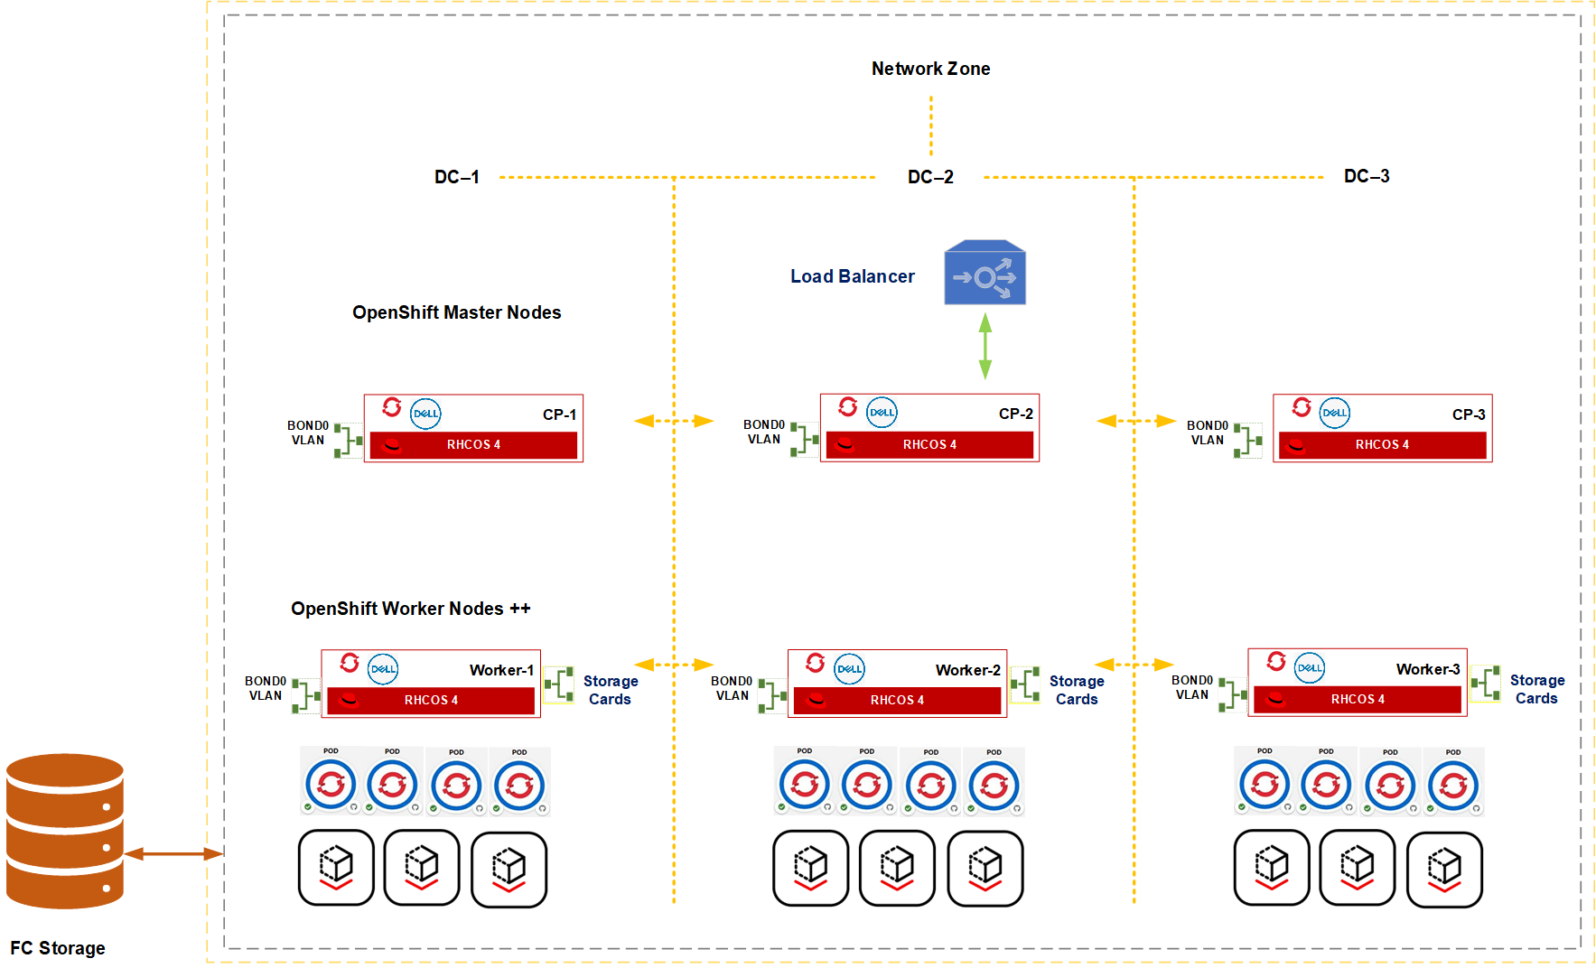
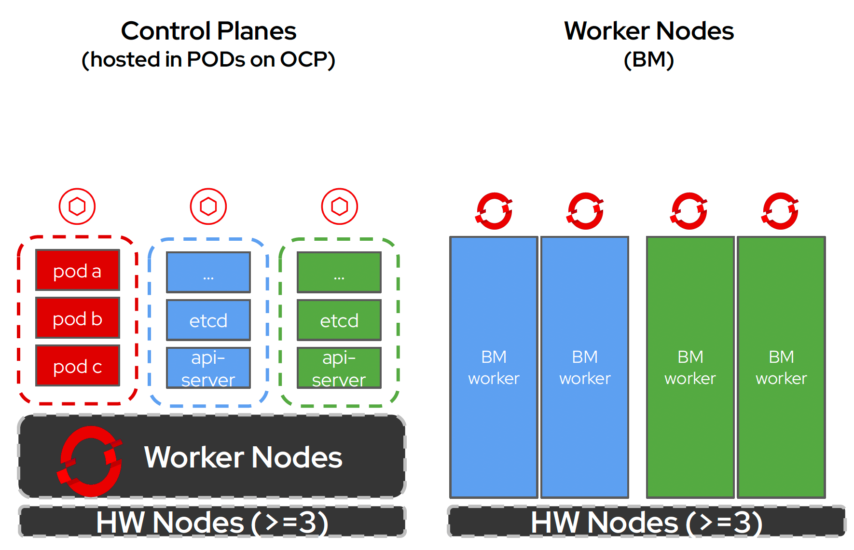
High Level Design- For 1 Network Zone

Slide 9
VM Workload Breakdown and Planning
The workload analysis shows easy/medium/hard distribution of workloads
Complexity | Total VMs | Percentage
✅ Easy | 21,200 | ~52.8%
⚠️ Medium | 12,600 | ~31.5%
❌ Hard | 3,200 | ~8.5%
Out of Scope | 3000 | ~8.0%
Easy: Low Complexity – Ready for Migration: 52.8% of workloads are easy candidates for migration.
RHEL 7, 8, 9 (7,500 VMs total): Fully supported; ideal for migration with minimal adjustments.
Ubuntu Server (2,500 VMs): Modern versions (18.04+) are compatible and migrate well.
Windows Server 2019 & 2022 (11,200 VMs): Stable, modern, and officially supported by OpenShift Virtualization.
Medium: Moderate Complexity – Requires Validation: 31.5% need careful validation and planning.
Windows Server 2016 (12,600 VMs): Mostly compatible but needs validation for tools, drivers, and networking post-migration.
Hard: High Complexity – Not Recommended for Direct Migration)
Windows Vista, XP, Server 2003 (2,200 VMs): Legacy, unsupported OSes. High risk and not compatible with OpenShift tooling.
Solaris & Other Unix (1,000 VMs): Unsupported platforms. Migration requires replatforming, containerization, or retirement.
Out of Scope- 3000 VMs Not considered for Migration and will need further evaluation

Slide 10
VM Workload Analysis
Prioritize migration of 'Easy' workloads (RHEL, Ubuntu, Windows Server 2019/2022)
Validate 'Medium' complexity workloads (Windows Server 2016) early in a test environment
Refactor, modernize, or retire 'Hard' workloads (Vista, XP, 2003, Solaris, Unix)
Use OpenShift Virtualization Migration Toolkit (MTV) for phased and automated migration
OS / Workload | Count | Complexity | Notes
Windows Vista | 560 | ❌ Hard | Unsupported legacy OS
Windows XP | 840 | ❌ Hard | Unsupported legacy OS
Windows Server 2003 | 2,800 | ❌ Hard | EOL; incompatible without heavy modification
Windows Server 2016 | 12,600 | ⚠️ Medium | Needs validation for drivers & services
Windows Server 2019 | 5,600 | ✅ Easy | Supported and stable
Windows Server 2022 | 5,600 | ✅ Easy | Fully compatible with OpenShift Virtualization
RHEL 7 | 3,500 | ✅ Easy | Fully supported
Ubuntu Server (modern) | 2,500 | ✅ Easy | Supported; verify version (18.04 or newer)
RHEL 8 | 3,000 | ✅ Easy | Kubernetes-friendly
RHEL 9 | 1,000 | ✅ Easy | Fully supported
Solaris | 600 | ❌ Hard | Unsupported
Other Unix (AIX, HP-UX) | 1,400 | ❌ Hard | Unsupported; needs refactoring

Slide 11
Phased Approach
Foundation Phase + Expansion Phase

Slide 12
Foundation Phase
Milestone | Description | Duration
M1.1 Environment Assessment | Inventory, workload profiling, infrastructure readiness | 4 weeks
M1.2 OpenShift Cluster Setup | Deploy OpenShift clusters on bare metal, storage integration | 6 weeks
M1.3 Network Configuration | Configure Juniper leaf-spine fabric, VLANs, security policies | 4 weeks
M1.4 Pilot Migration & Testing | Migrate pilot workloads, validate performance | 6 weeks
M1.5 Automation & GitOps Pipeline Setup | Implement GitOps workflows and tooling | 8 weeks
M1.6 Training & Enablement | Train teams on OpenShift, virtualization, GitOps | 4 weeks
The Foundation Phase, spanning 6 months, establishes the technical and operational groundwork for the Telco’s migration from VMware to OpenShift Virtualization on bare metal. This phase includes a comprehensive assessment of existing infrastructure, deployment of pilot OpenShift clusters across selected data centers, and integration with existing network and storage systems. Key focus areas include the setup of GitOps-based automation, initial workload migration (targeting modern Windows/Linux systems), and upskilling teams on OpenShift, virtualization, and CI/CD tools. The outcome of this phase is a validated, production-ready OpenShift platform capable of running both VM and container workloads, supported by hardened security controls, and a clear roadmap for large-scale expansion.

Slide 13
Foundation Phase- Cost Break-Up
Cost Category | Description | Estimated Cost (USD)
Hardware Refresh (30%) | Selective new hardware purchase and reuse validation | $3,500,000
OpenShift Cluster Setup | Bare metal OpenShift + KubeVirt deployment & integration | $1,000,000
Storage & Network Integration | Multi-vendor storage integration & network config | $1,600,000
Pilot Migration & Testing | Workload profiling and pilot migrations | $1,200,000
Automation & GitOps Setup | Pipeline development, GitOps tooling & training | $1,000,000
Project Management & Contingency | Governance and risk buffers | $3,200,000
Total Foundation Phase |  | $11,500,000

Slide 14
Expansion Phase
Milestone | Description | Duration
M2.1 Scale OpenShift Across Sites | Deploy and configure clusters in all 12 data centers | 12 months
M2.2 Bulk Workload Migration | Migrate IT and telco workloads (vEPC, vRAN, databases, apps) | 18-24 months
M2.3 DR & Backup Setup | Implement disaster recovery and backup solutions | 6 months
M2.4 Security Hardening & Compliance | Apply security policies, audits, and compliance checks | 8 months
M2.5 Expand Automation & Monitoring | Extend GitOps, CI/CD, monitoring to all workloads | 12 months
M2.6 Ongoing Training & Support | Continuous skill development and operational support | Ongoing
M2.7 Stabilization & Optimization | Performance tuning, cost optimization, operational handover | 6 months
The Expansion Phase, running over 35–40 months, focuses on scaling the OpenShift Virtualization platform across all 12 data centers, enabling the migration of over 1440 hypervisors and thousands of workloads, including critical telco (vEPC, vRAN) and IT workloads (e.g., SQL, .NET, JBoss). During this phase, the platform is extended zone-by-zone, with full implementation of multi-zone high availability, disaster recovery, and GitOps automation across environments. Security and compliance frameworks are further hardened, and operational workflows are stabilized. This phase completes the full transition from VMware, achieves significant cost reduction, and positions the Telco for cloud-native agility, hybrid readiness, and long-term operational efficiency.

Slide 15
Expansion Phase- Cost Break-Up
Cost Category | Description | ROM Cost (USD)
Hardware Support for remaining hardware | Remaining hardware procurement aligned to refresh cycles | $4,000,000
Workload Migration | Bulk migration of IT & Telco workloads | $15,000,000
DR & Backup Implementation | Multi-zone disaster recovery setup | $1,200,000
Automation & CI/CD Expansion | Enhanced GitOps pipelines & monitoring | $2,000,000
Security & Compliance | Hardening, auditing, policy enforcement | $1,000,000
Operational Support | Extended support & troubleshooting | $6,500,000
Total Expansion Phase |  | $29,700,000

Slide 16
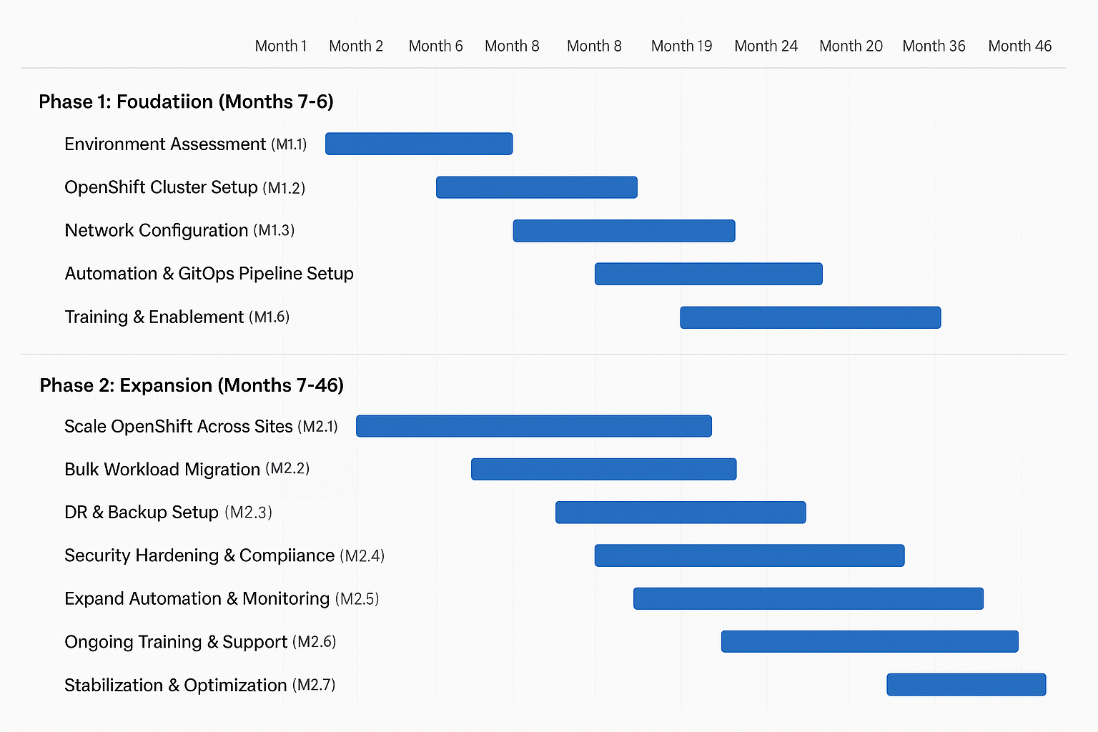
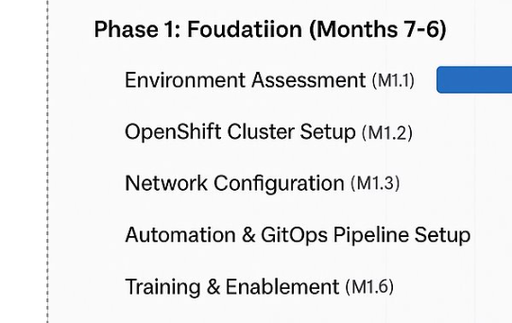
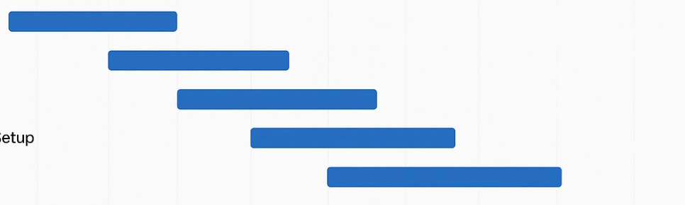
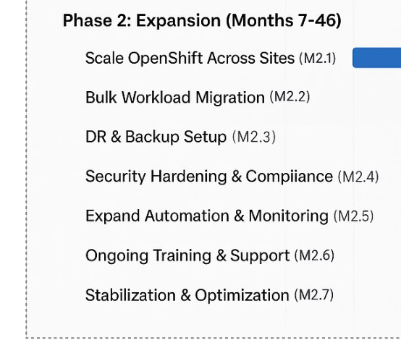

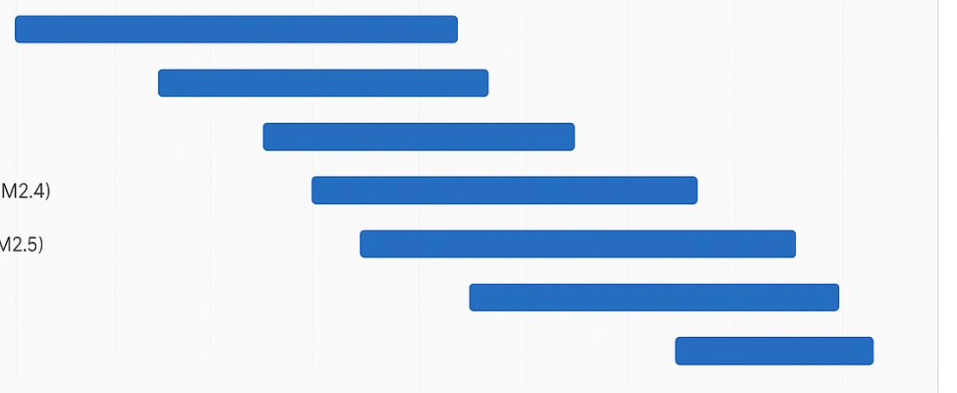

Telco’s Migration Timeline with Containerization

Slide 17
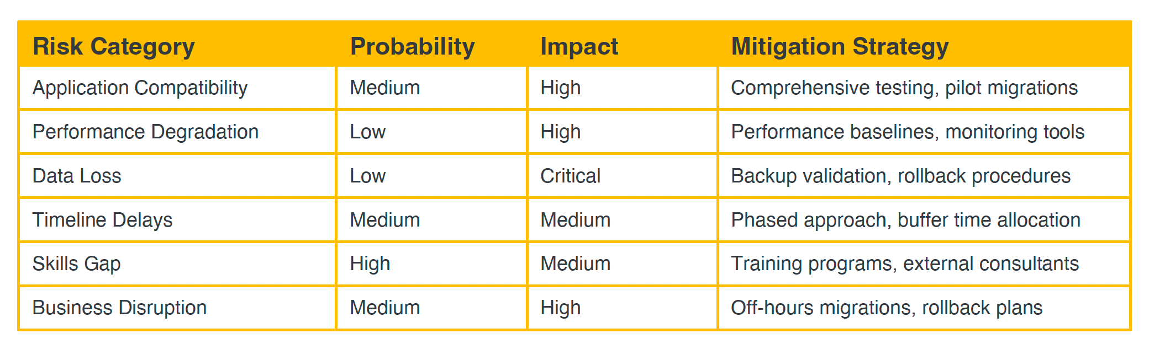
Migration - Risk Assessment & Mitigation

Slide 18
Migration Estimate Assumptions
Hardware reuse prioritized; ~30% refreshed during foundation, remainder phased over migration.
Migration downtime windows are scheduled with minimal impact.
Cost estimates exclude internal labor, facilities, and power costs.
Subscription pricing reflects standard Red Hat contracts; may vary by negotiation.
VMware licensing and maintenance fees cease post-migration, generating cost savings not included here.
Operational efficiencies and automation benefits expected to reduce manual effort by 15-20%.

Slide 19
Next Steps: Proof of Value (PoV)
Select Representative Workloads Identify ‘Easy’ IT workloads (e.g., SQL, .NET) for PoV migration.
Deploy OpenShift Virtualization Pilot Cluster Set up a minimal cluster on existing hardware to validate performance and integration.
Integrate Storage & Networking Test CSI drivers, VLAN segmentation, and performance benchmarks with real traffic.
Implement GitOps Pipelines Deploy automation workflows using tools like ArgoCD for VM and app lifecycle.

Slide 20

Thank You

